Slide 1
What’s the Point? Turning Complex Analyses into Actionable Stories
Benjamin Burch, PhD
Carthage Guest Lecture
April 29, 2025
benjaminburch@gmail.com
https://www.linkedin.com/in/benjaminburch/

Slide 2

Hi! I’m Ben — a Carthage College graduate who started out pre-med somehow stumbled into math, physics, and a career in data science. I lead a team of Data Scientists at Midwest Employers Casualty (a Berkley Company), building machine learning and AI tools that help insurance professionals identify the best course of action for employees injured on the job. One of my favorite projects? Using deep learning to create a custom Natural Language Processing model to recognize medications across thousands of millions pages of messy claims documentation. Before jumping into industry, I earned my PhD in Physics at Washington University in St. Louis where I studied dark matter, cosmic rays and bubbles. I also taught a few courses on SQL at Maryville University along the way. I'm excited to be back at Carthage — and even more excited to help you think about how you can turn your analysis into stories that drive action.

Slide 3
Outline
Why Data Visualization Matters
Cognitive Load & Visual Perception
Gestalt Principles of Visual Grouping
Data Storytelling Techniques
Visualization Do’s and Don’ts
Tools of the Trade

Slide 4
Why Data Visualization Matters
Enables pattern recognition and comparison
Reveals trends, outliers, and relationships not visible in raw tables
Helps bridge the gap between technical analysis and business decisions
Empowers audiences — technical or not — to ask better questions

Slide 5

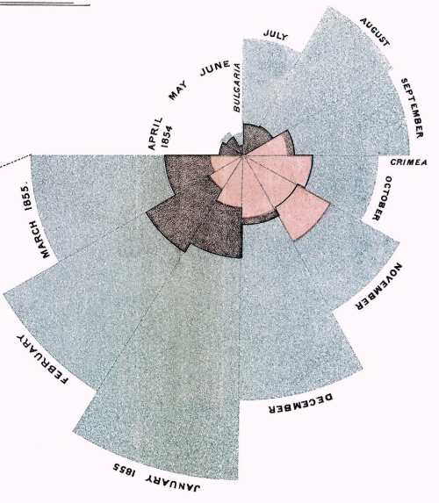
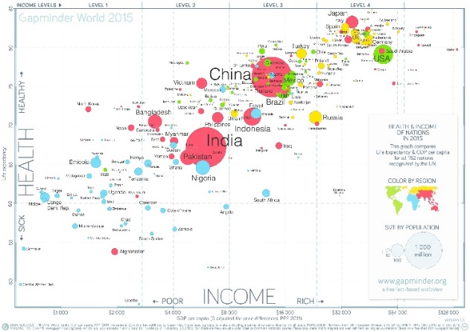
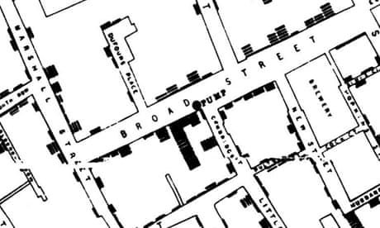
Good Visuals Drive Action
Florence Nightingale’s 1858 coxcomb diagram
John Snow’s 1854 cholera map
Hans Rosling’s 200 Countries, 200 Years, 4 Minutes Bubble chart

Slide 6
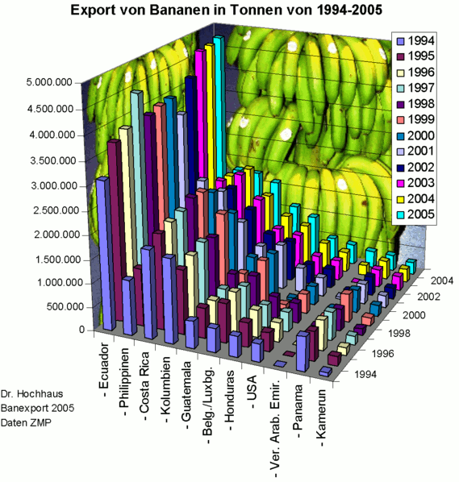
Bad Visuals are Confusing!
Did the USA or Honduras export more bananas in 2001?
Did the UAE export more of fewer bananas between 1996 and 1998?
Approximately how many bananas were exported by Columbia in 1999?
How does the Philippines compare to Columbia?

Slide 7
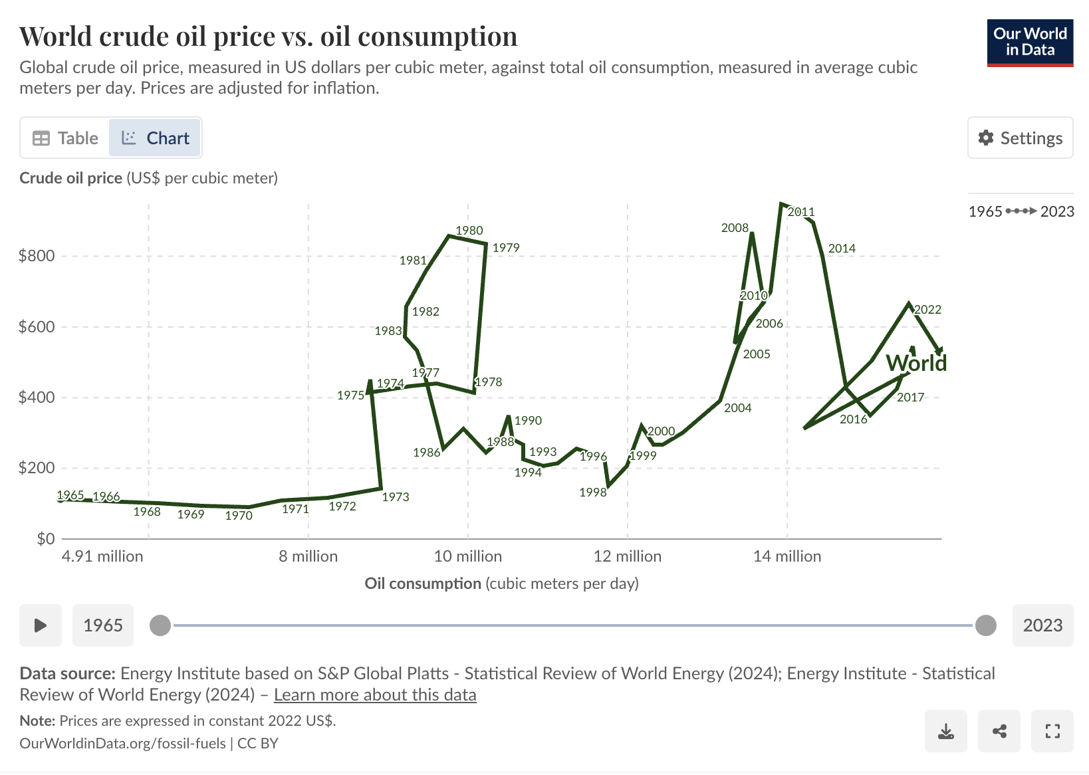
Bad Visuals are Confusing!

Slide 8
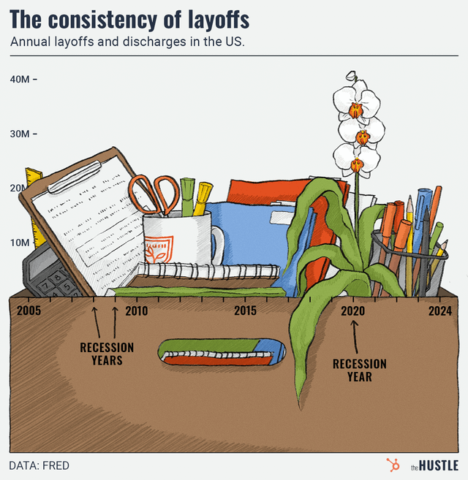
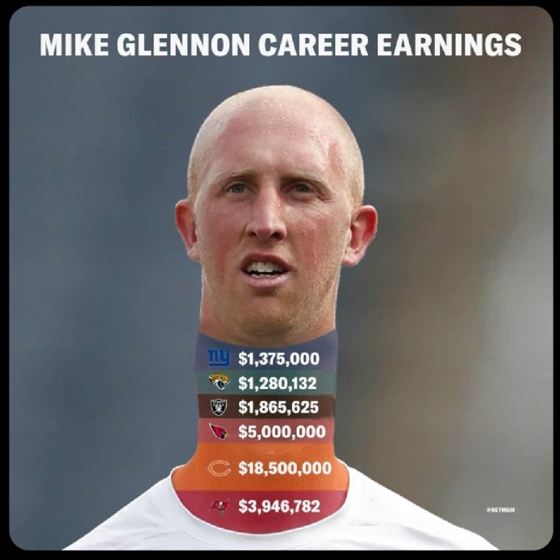
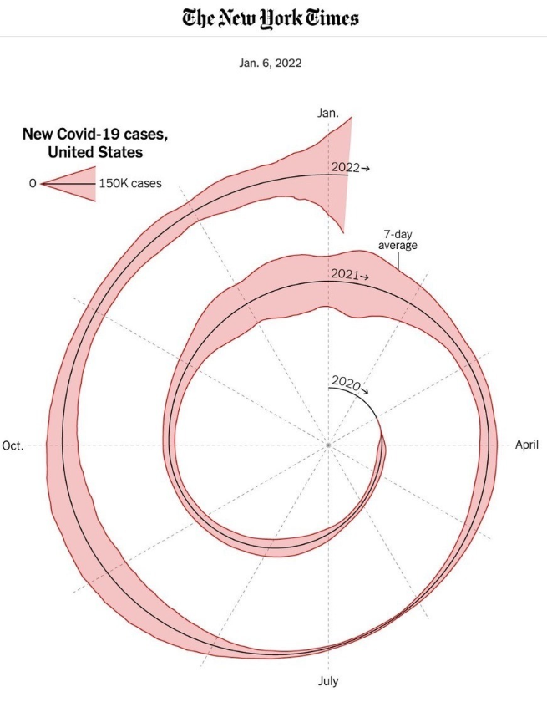
Bad Visuals are Confusing!

Slide 9
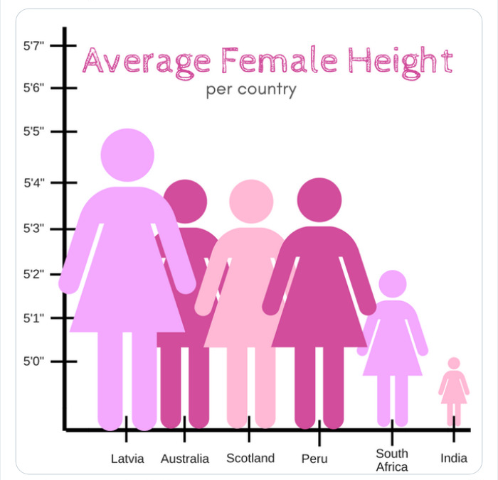
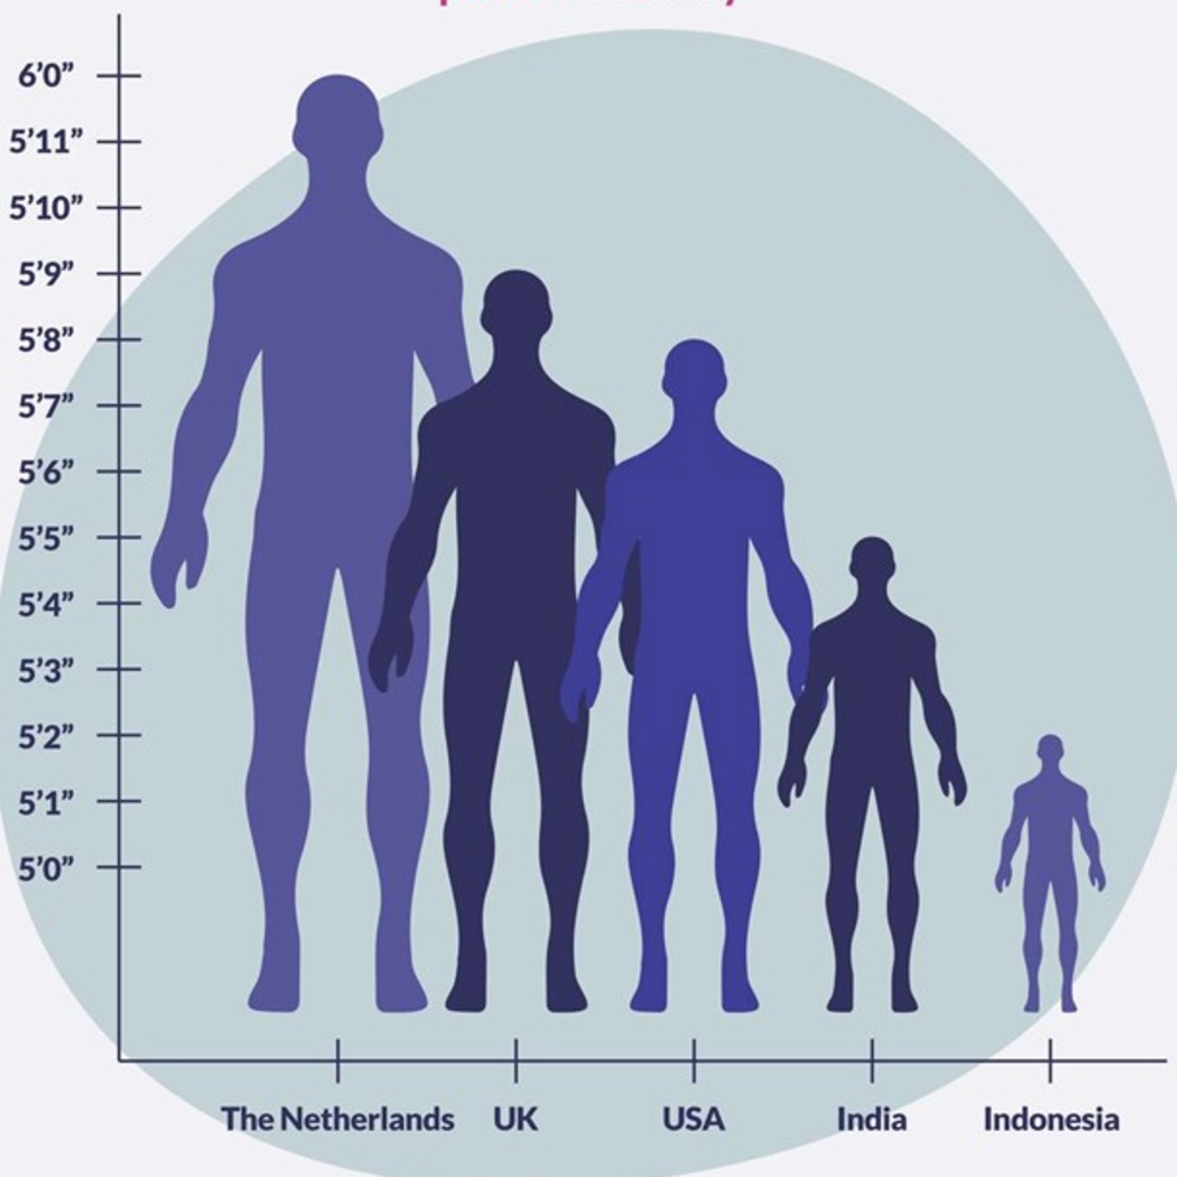
Bad Visuals are Confusing

Slide 10

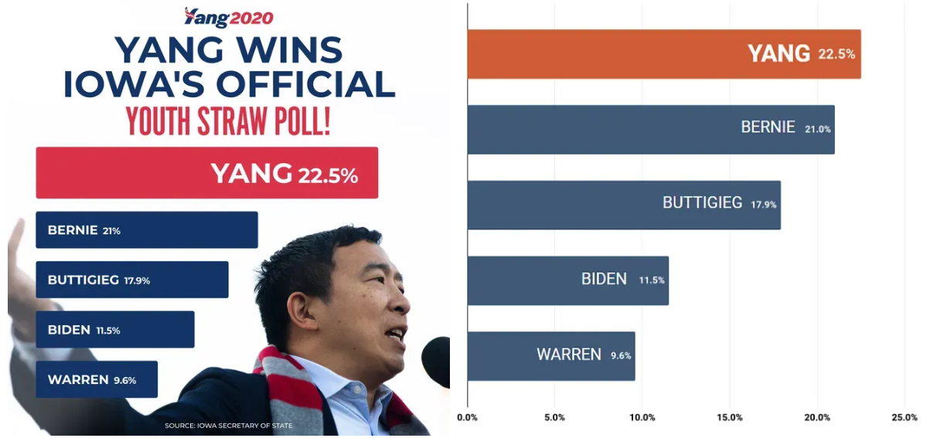
Worse, Bad Visuals Lead to Misinformation!
Florida Gun Deaths
Political Ad

Slide 11
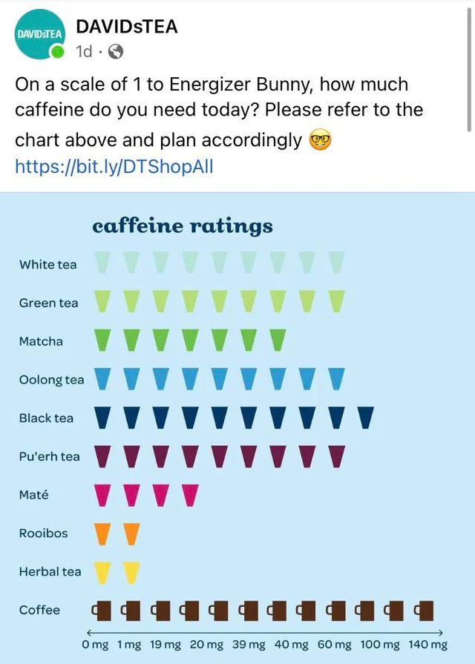
Do you see what is wrong here?

Slide 12
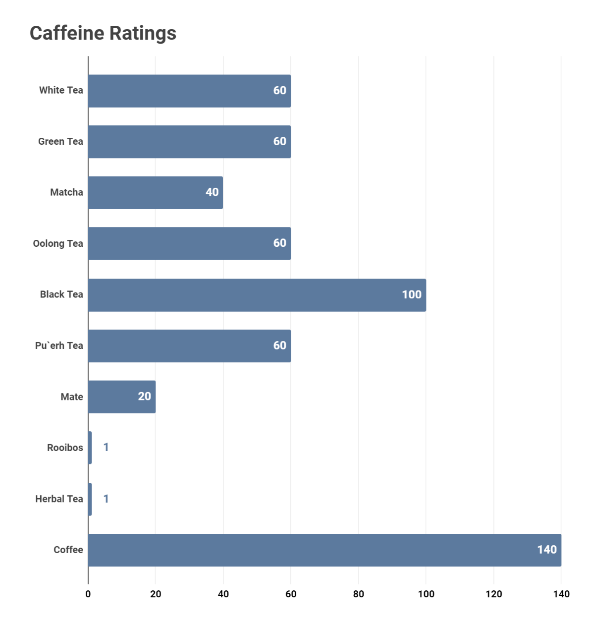
Do you see what is wrong here?

Slide 13
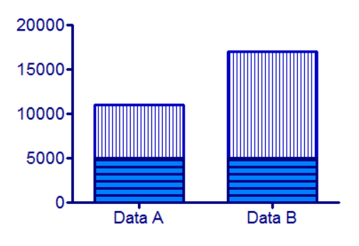
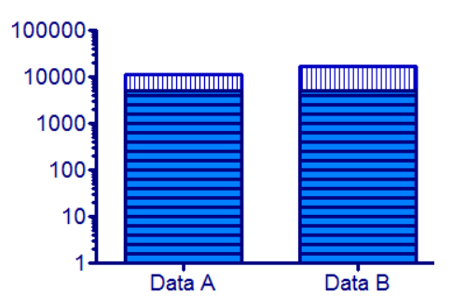
Beware of Log Scales
VS

Slide 14
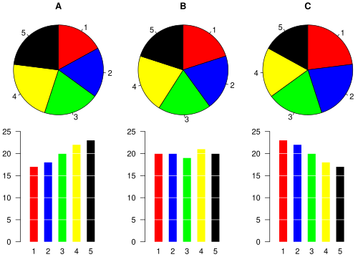
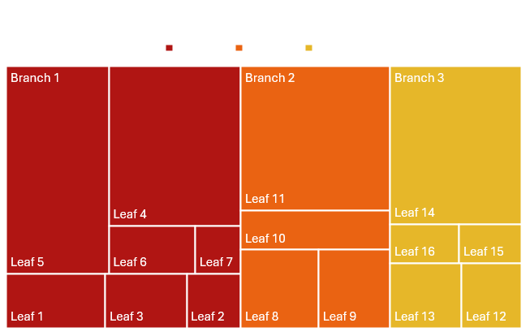
Beware of Pie-like Charts
Arc length
Can you tell which #3 is the smallest without looking at the bars?
Area
Is Leaf 7 or Leaf 15 bigger?
What about Leaf 1 and Leaf 12?

Slide 15
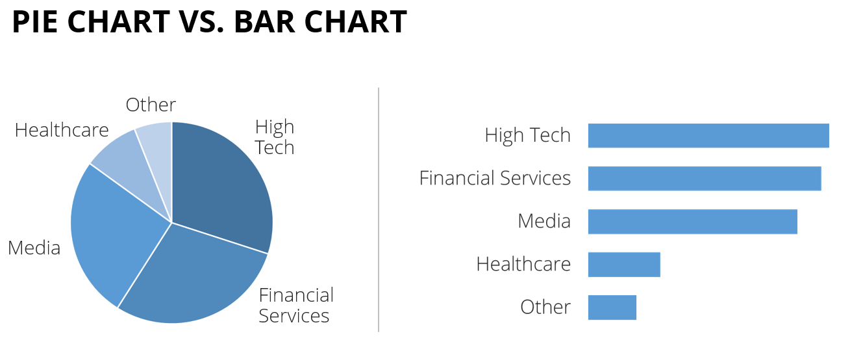
LEARN MORE HERE!

Slide 16
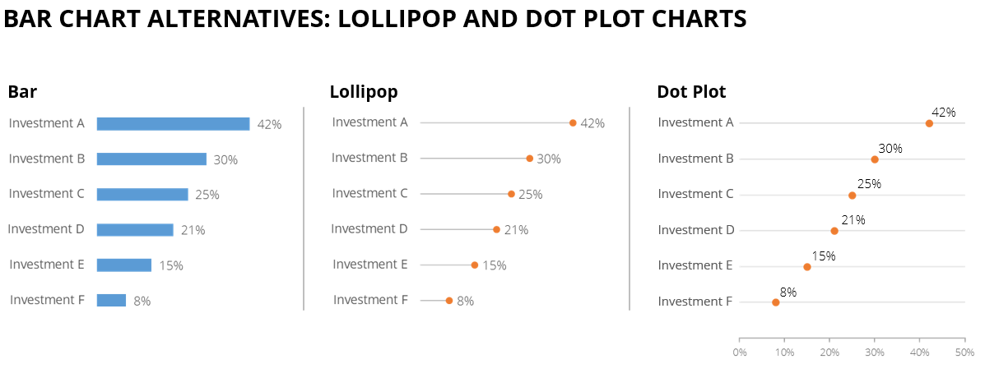
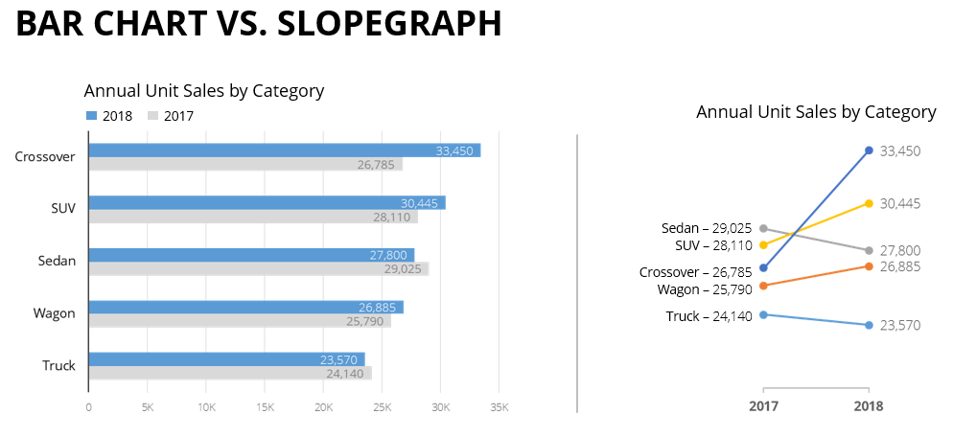
LEARN MORE HERE!

Slide 17
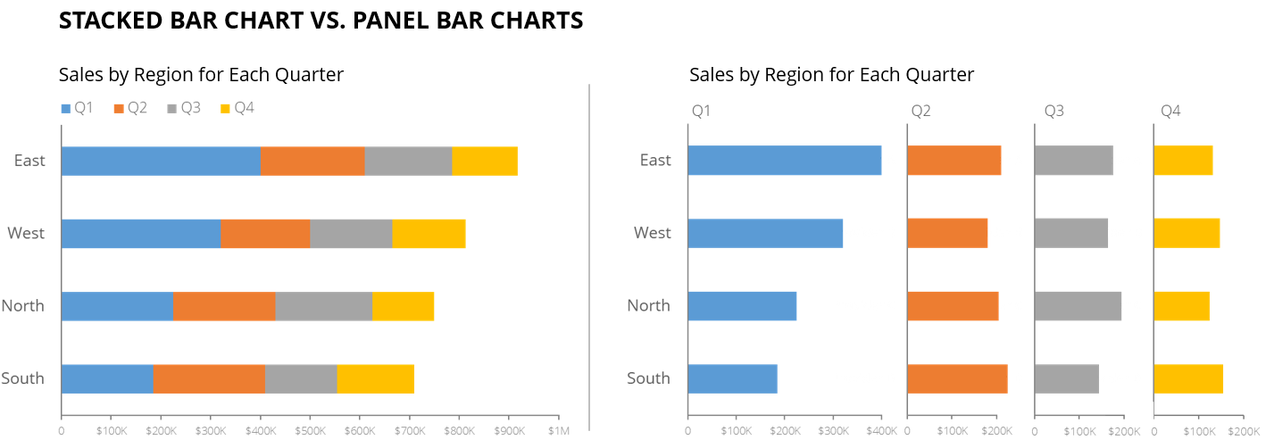
LEARN MORE HERE!

Slide 18
How do we make good visuals?
Reduce Cognitive Load
Leverage HUMAN Psychology
TELL A STORY
Don’t Over-Complicate Things!
LEARN MORE HERE

Slide 19


Cognitive Load
Intrinsic Load
The complexity of the data itself
Examples:
High-dimensional datasets
Unfamiliar metrics
Non-standard graph types
Extraneous Load
Unnecessary cognitive effort caused by poor visual design
Examples:
3D charts
Unclear color schemes
Wrong graph type
Germane Load
Efforts that help the audience learn and understand
Examples:
Highlighting key insights
Annotations and data labels
Building narrative
Good visualizations reduce extraneous load and promote germane load.
LEARN MORE HERE

Slide 20
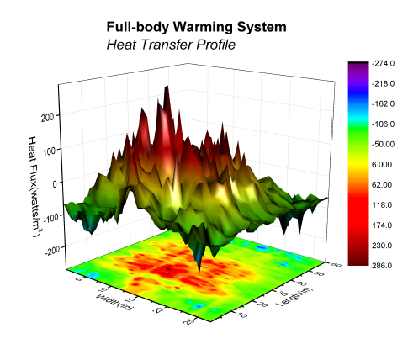
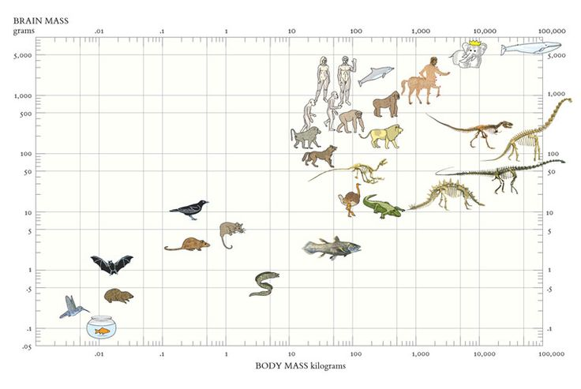
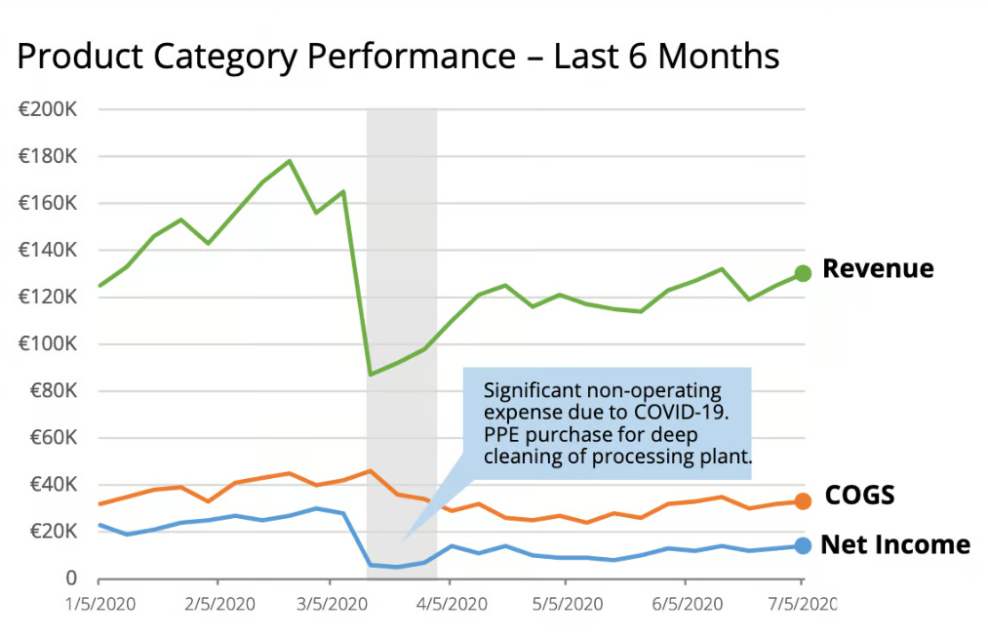
Cognitive Load
Intrinsic Load
Extraneous Load
Germane Load
Analytical Graph
Cutesy Chart Junk
Explanatory Graph
Good visualizations reduce extraneous load and promote germane load.
LEARN MORE HERE

Slide 21
Strategies for Reducing Cognitive Load
Principle | What It Means | Example
Minimize clutter | Avoid chart junk | Remove unnecessary gridlines, colors, reduce unneeded categories
Use pre-attentive attributes | Leverage color, shape, size | Highlight key line in a line chart
Group related elements | Align with Gestalt | Put labels close to data points Use similar colors for similar data
Progressive disclosure | Don’t show everything at once | Dashboard tabs or filters, data stories

Slide 22
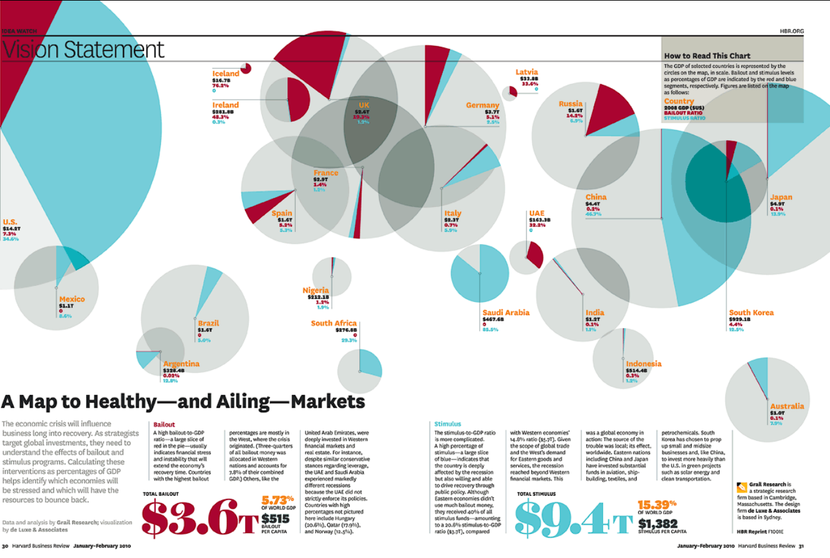
Chart Junk
Chart Junk is any visual element of a graph that is not necessary to understand the information represented on the graph.

Slide 23
Chart Junk
THIS IS A BAD SIGN!

Slide 24
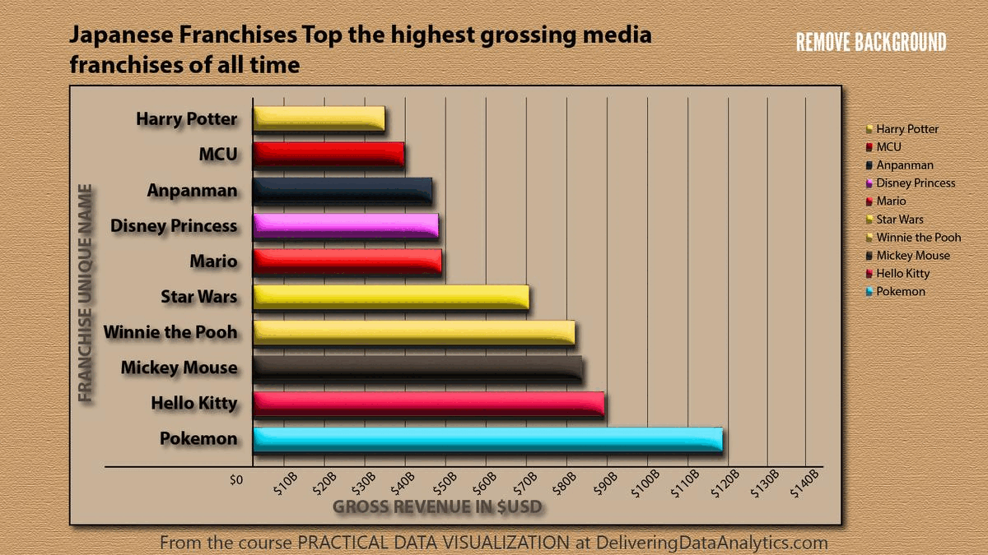
Identify the Junk

Slide 25
Removing Chart Junk

Slide 26
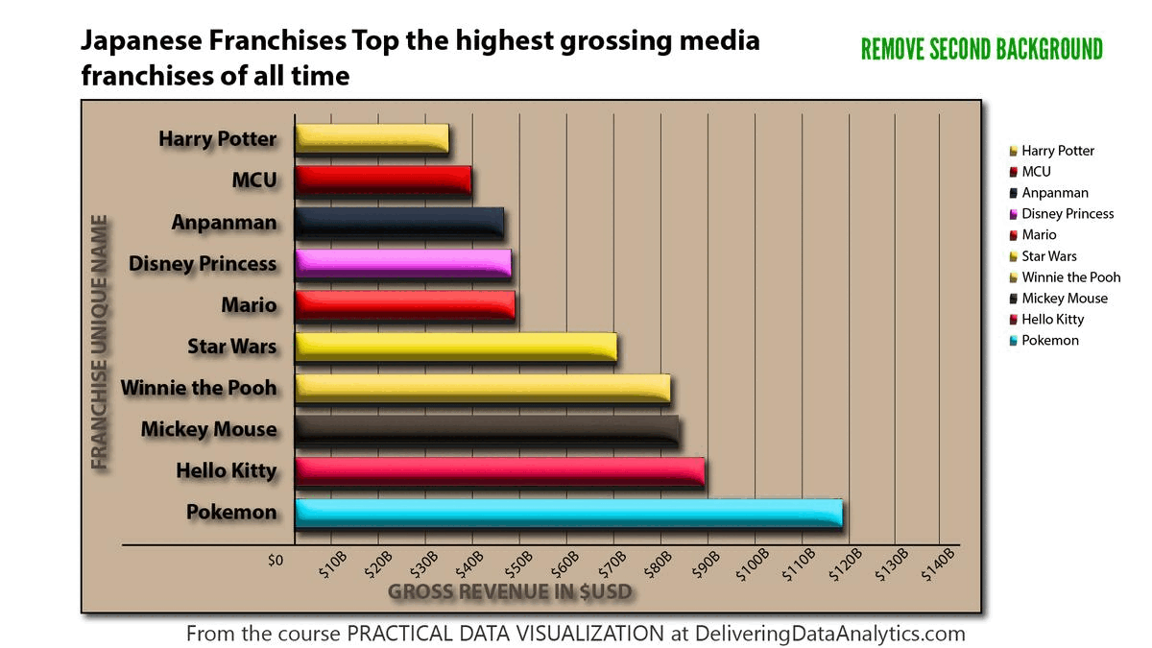
Removing Chart Junk

Slide 27
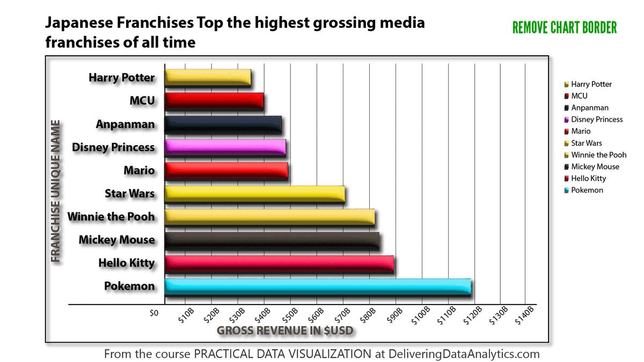
Removing Chart Junk

Slide 28

Removing Chart Junk

Slide 29

Removing Chart Junk

Slide 30
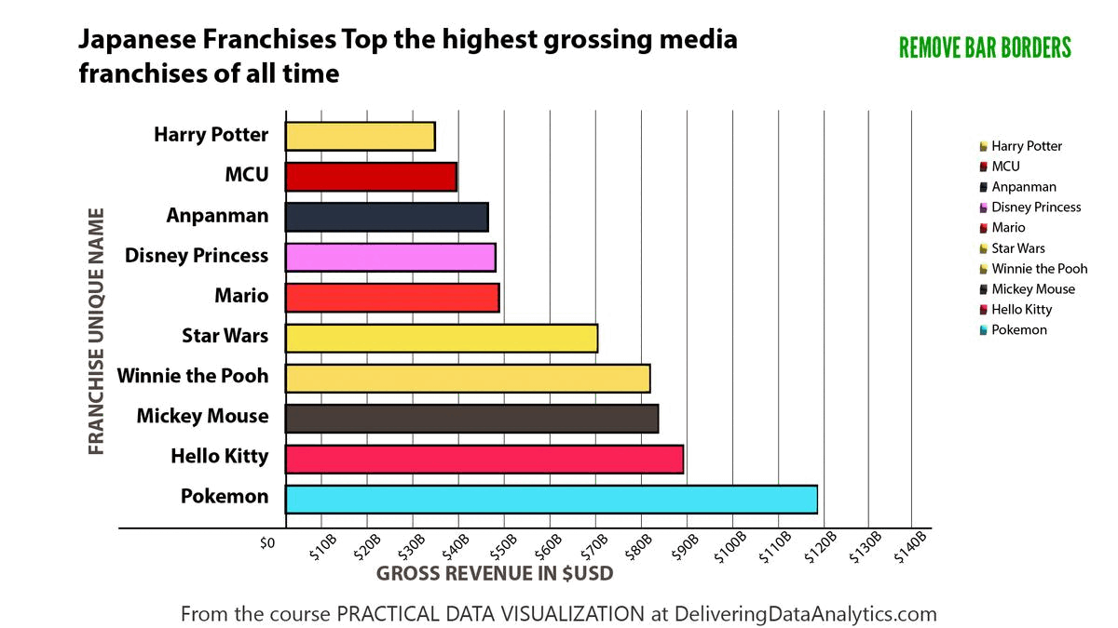
Removing Chart Junk

Slide 31
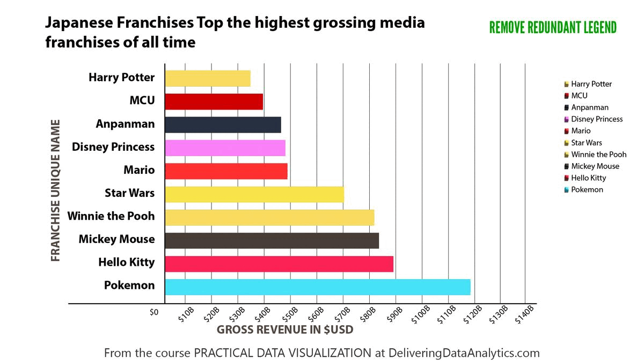
Removing Chart Junk

Slide 32
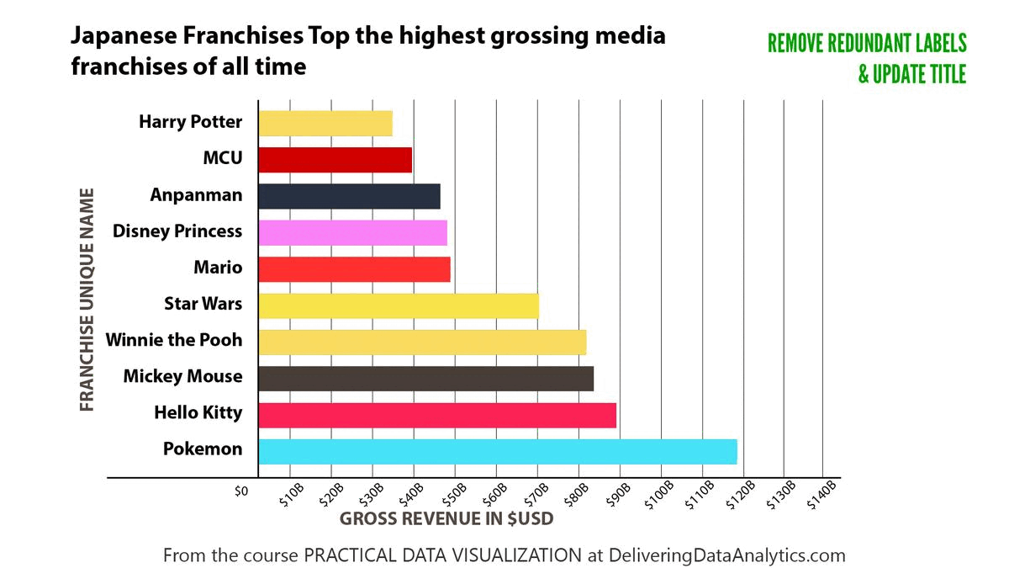
Removing Chart Junk

Slide 33
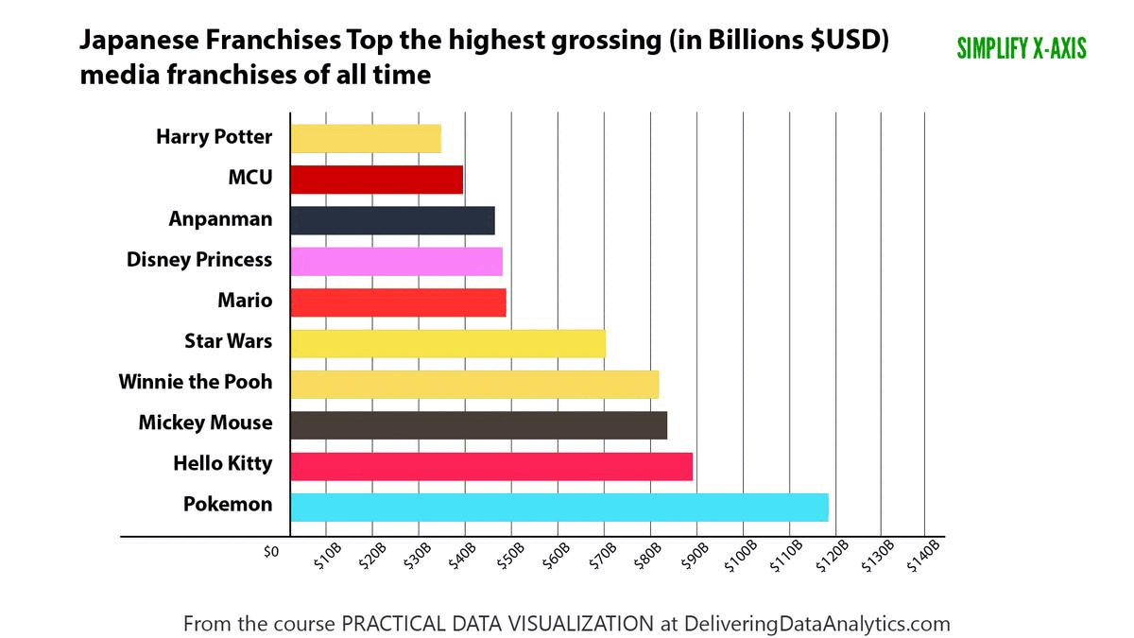
Removing Chart Junk

Slide 34
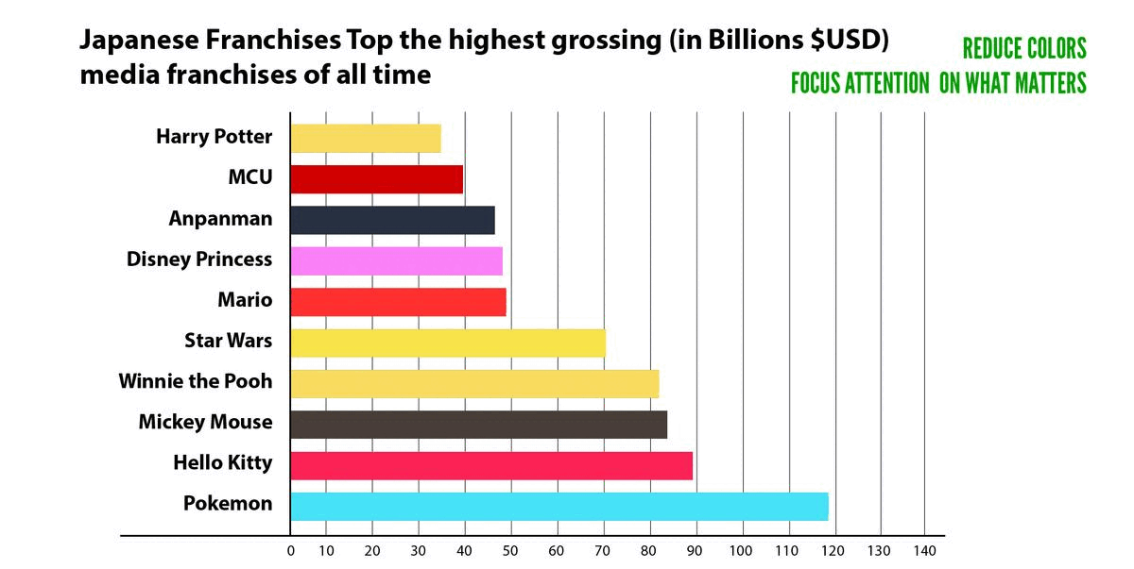
Removing Chart Junk

Slide 35
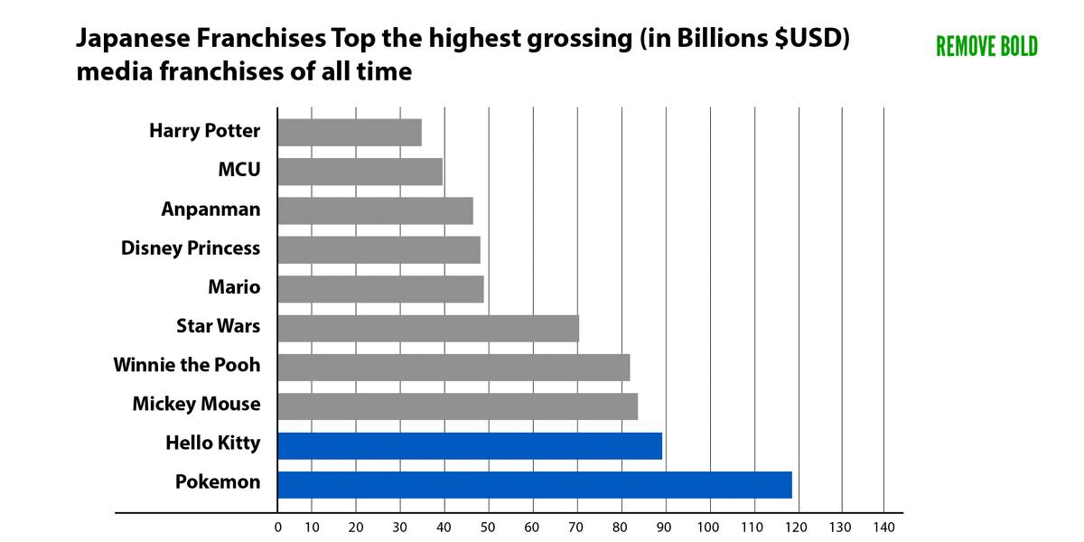
Removing Chart Junk

Slide 36
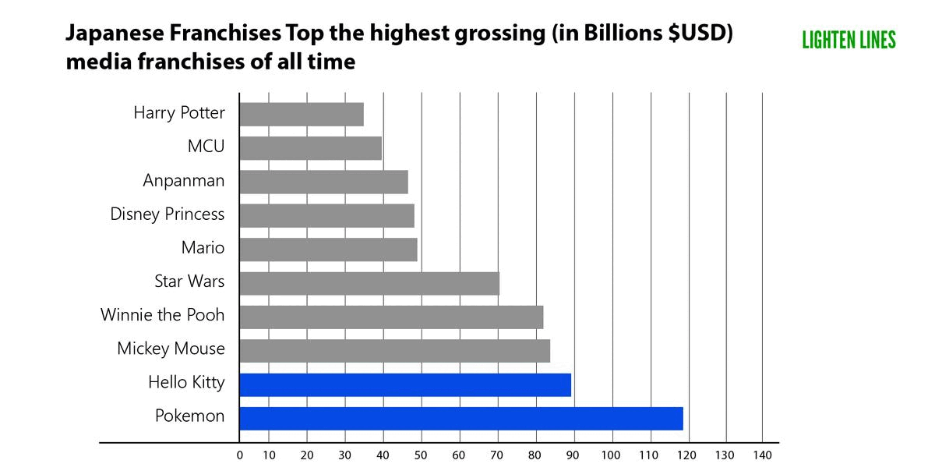
Removing Chart Junk

Slide 37
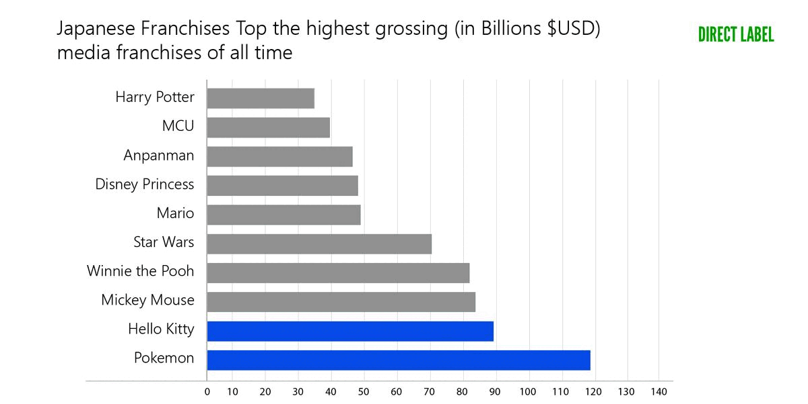
Removing Chart Junk

Slide 38
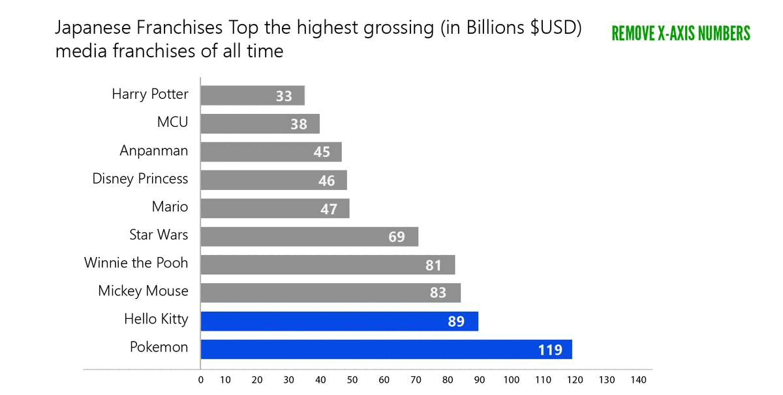
Removing Chart Junk

Slide 39
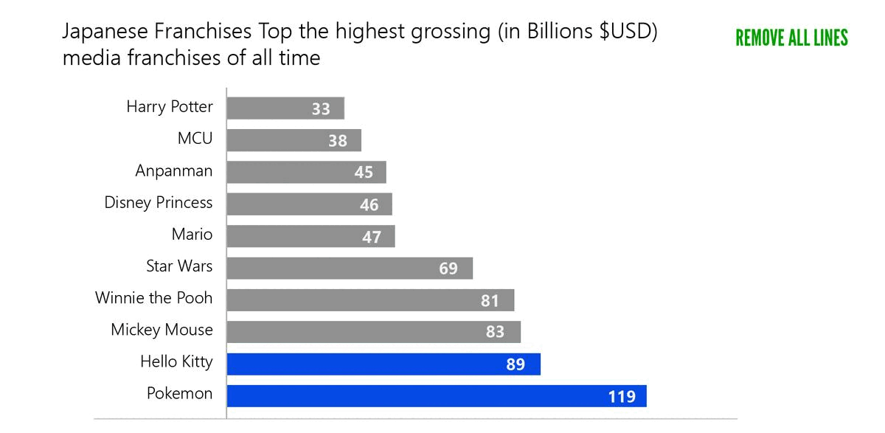
Removing Chart Junk

Slide 40

Removing Chart Junk

Slide 41
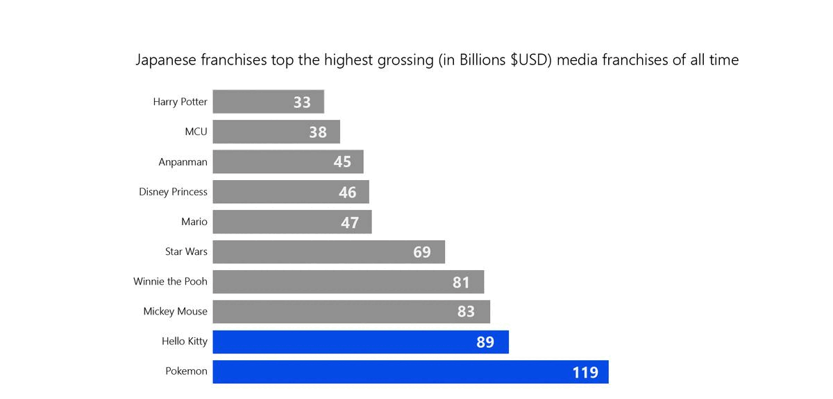
Removing Chart Junk

Slide 42

LEARN MORE HERE

Slide 43
Identify the Junk

Slide 44
Removing Chart Junk

Slide 45
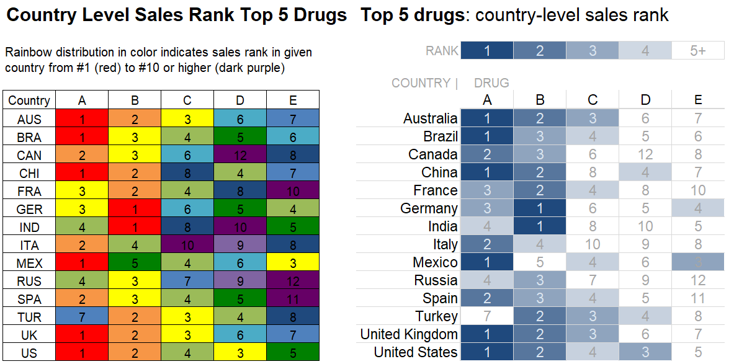
Works for Tables too!

Slide 46
How do you focus on what’s important?

Slide 47
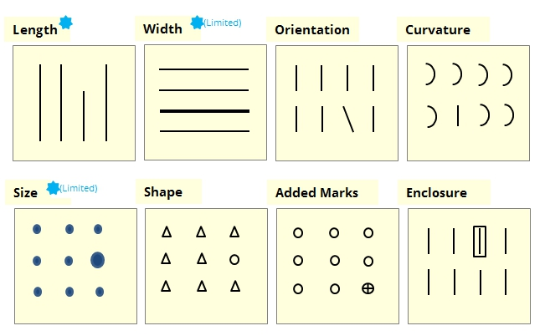
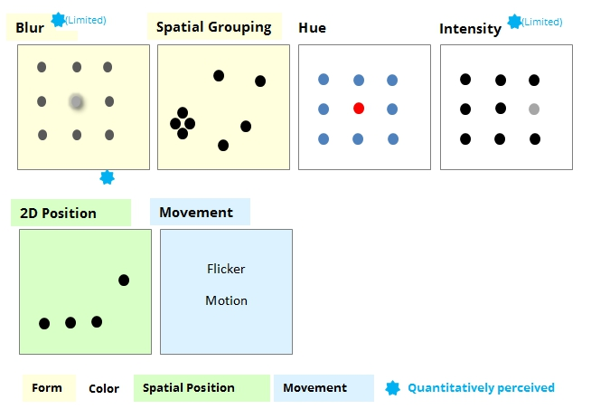
Pre-attentive Attributes
Pre-attentive attributes are visual properties that the human brain processes almost instantly, without conscious effort.
LEARN MORE HERE

Slide 48
Find all the 3’s
7 3 4 5 6 5 6 7 9 0 8 7 5 4 2 3 4 5 6
0 6 7 8 9 1 2 3 2 6 8 3 4 6 8 0 7 3 2
0 2 1 7 9 5 3 7 1 3 9 7 4 5 8 2 6 4 9
9 6 2 5 8 7 4 3 5 8 8 8 4 2 4 2 1 5 8
9 9 6 8 5 8 7 7 4 3 3 1 0 2 5 8 5 2 3
2 5 8 7 4 6 9 8 5 2 1 4 3 6 9 8 5 1 2

Slide 49
Find all the 3’s – Orientation
7 3 4 5 6 5 6 7 9 0 8 7 5 4 2 3 4 5 6
0 6 7 8 9 1 2 3 2 6 8 3 4 6 8 0 7 3 2
0 2 1 7 9 5 3 7 1 3 9 7 4 5 8 2 6 4 9
9 6 2 5 8 7 4 3 5 8 8 8 4 2 4 2 1 5 8
9 9 6 8 5 8 7 7 4 3 3 1 0 2 5 8 5 2 3
2 5 8 7 4 6 9 8 5 2 1 4 3 6 9 8 5 1 2

Slide 50
Find all the 3’s – 2D Position
7 34 5 6 5 6 7 9 0 8 7 5 4 2 34 5 6
0 6 7 8 9 1 2 32 6 8 34 6 8 0 7 32
0 2 1 7 9 5 37 1 39 7 4 5 8 2 6 4 9
9 6 2 5 8 7 4 35 8 8 8 4 2 4 2 1 5 8
9 9 6 8 5 8 7 7 4 33 1 0 2 5 8 5 2 3
2 5 8 7 4 6 9 8 5 2 1 4 36 9 8 5 1 2

Slide 51
Find all the 3’s – Size
7 3 4 5 6 5 6 7 9 0 8 7 5 4 2 3 4 5 6
0 6 7 8 9 1 2 3 2 6 8 3 4 6 8 0 7 3 2
0 2 1 7 9 5 3 7 1 3 9 7 4 5 8 2 6 4 9
9 6 2 5 8 7 4 3 5 8 8 8 4 2 4 2 1 5 8
9 9 6 8 5 8 7 7 4 3 3 1 0 2 5 8 5 2 3
2 5 8 7 4 6 9 8 5 2 1 4 3 6 9 8 5 1 2

Slide 52
Find all the 3’s – Enclosure
7 3 4 5 6 5 6 7 9 0 8 7 5 4 2 3 4 5 6
0 6 7 8 9 1 2 3 2 6 8 3 4 6 8 0 7 3 2
0 2 1 7 9 5 3 7 1 3 9 7 4 5 8 2 6 4 9
9 6 2 5 8 7 4 3 5 8 8 8 4 2 4 2 1 5 8
9 9 6 8 5 8 7 7 4 3 3 1 0 2 5 8 5 2 3
2 5 8 7 4 6 9 8 5 2 1 4 3 6 9 8 5 1 2

Slide 53
Find all the 3’s – Hue
7 3 4 5 6 5 6 7 9 0 8 7 5 4 2 3 4 5 6
0 6 7 8 9 1 2 3 2 6 8 3 4 6 8 0 7 3 2
0 2 1 7 9 5 3 7 1 3 9 7 4 5 8 2 6 4 9
9 6 2 5 8 7 4 3 5 8 8 8 4 2 4 2 1 5 8
9 9 6 8 5 8 7 7 4 3 3 1 0 2 5 8 5 2 3
2 5 8 7 4 6 9 8 5 2 1 4 3 6 9 8 5 1 2

Slide 54
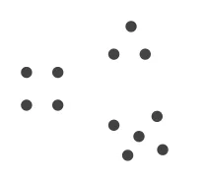
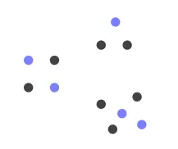
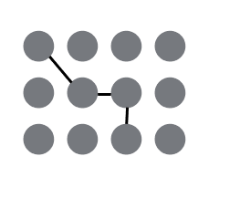
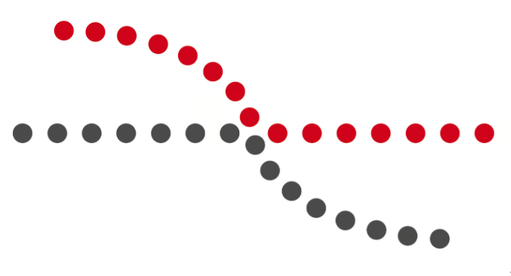
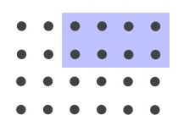
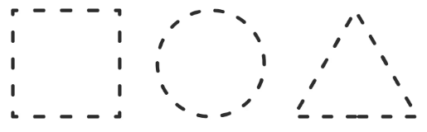
Gestalt Principles
Gestalt principles describe the subconscious rules our brain uses to spot patterns—why spacing, color, shape, and lines in a chart instantly snap separate marks into meaningful groups before we even think about it.
Proximity
Similarity
Connection
Closure
Continuity
Enclosure
There are many more Gestalt rules
LEARN MORE HERE!

Slide 55
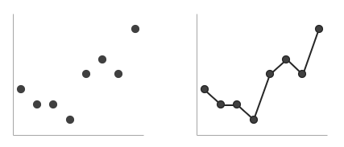
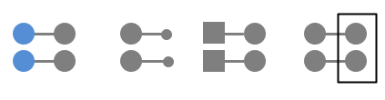
Connection
PRINCIPLE
APPLICATION
LEARN MORE HERE!

Slide 56


Closure
PRINCIPLE
APPLICATION
LEARN MORE HERE!

Slide 57

Continuity
PRINCIPLE
APPLICATION
LEARN MORE HERE!

Slide 58


Enclosure
PRINCIPLE
APPLICATION
LEARN MORE HERE!

Slide 59

Works for Tables too!
LEARN MORE HERE!

Slide 60


Proximity
PRINCIPLE
APPLICATION
LEARN MORE HERE!

Slide 61


Similarity
PRINCIPLE
APPLICATION
LEARN MORE HERE!

Slide 62

Match your visual to your message
LEARN MORE HERE
AND HERE

Slide 63





How to choose?
LEARN MORE HERE
AND HERE

Slide 64


















Tools of the Trade
Python
Matplotlib
Bokeh
Altair
Seaborn
Streamlit (apps)
Gradio (apps)
R
Built-in graphics library
ggplot2
Shiny (apps)
Python and R
Plotly
Dash (apps)
Javascript
D3
Other
Power BI (dashboards)
Tableau (dashboards)
Excel

Slide 65
Data Storytelling
What Makes a Data Story
Data Foundation
Main Point
Explanatory Focus
Linear Sequence
Dramatic Elements
Visual Anchors
How do you do it?
Get the Right Data
Create the Right Visualizations
Put them in the Right Order
Remove Noise
Focus Attention
Make it Approachable
Instill Trust
LEARN MORE HERE!
AND HERE!

Slide 66

Focusing Attention

Slide 67

LEARN MORE HERE!

Slide 68

LEARN MORE HERE!

Slide 69

LEARN MORE HERE!

Slide 70

LEARN MORE HERE!

Slide 71

LEARN MORE HERE!

Slide 72

Putting It All Together
LEARN MORE HERE!

Slide 73

Progressive Disclosure
Tell a story!
LEARN MORE HERE!

Slide 74

Progressive Disclosure
Tell a story!
LEARN MORE HERE!

Slide 75

Progressive Disclosure
Tell a story!
LEARN MORE HERE!

Slide 76

Progressive Disclosure
Tell a story!
LEARN MORE HERE!

Slide 77


Slide 78


Now That’s a Story!

Slide 79


How Katy Perry can beat Taylor Swift

Slide 80
Thank you!

